Slide 1

Failed Banking Transaction Analysis
Goal: Build a cloud pipeline to analyze failed transactions across bank branches. Presented by Tharunteja Nakkala.
Notes:
Slide 1: Project Title Project Name: Failed Banking Transaction AnalysisPresented by: Tharunteja NakkalaGoal: Build an end-to-end cloud pipeline to analyze failed transactions across multiple bank branches

Slide 2





Problem Statement
High Transaction Volume
Banks process thousands of transactions daily.
Failures Impact
Failures cause customer frustration and financial issues.
Manual Analysis
Manual failure analysis is time-consuming.
Solution
Automated cloud-based analysis system proposed.

Slide 3
Project Objective
Data Ingestion
Data Processing
Data Storage & Visualization
Collect CSVs from 15 branches across 3 cities.
Clean and merge data using PySpark.
Load filtered data into Cloud SQL (MySQL).
Each CSV has 200 records from last 7 days.
Filter failed transactions for analysis.
Visualize trends via BigQuery and Looker Studio.

Slide 4

Tools & Technologies
Google Cloud Storage
Google Cloud Dataproc
Stores raw and processed data securely.
Runs PySpark jobs for data processing.
Cloud SQL
BigQuery & Looker Studio
Stores filtered failed transaction data.
Analyze data and create visual dashboards.

Slide 5
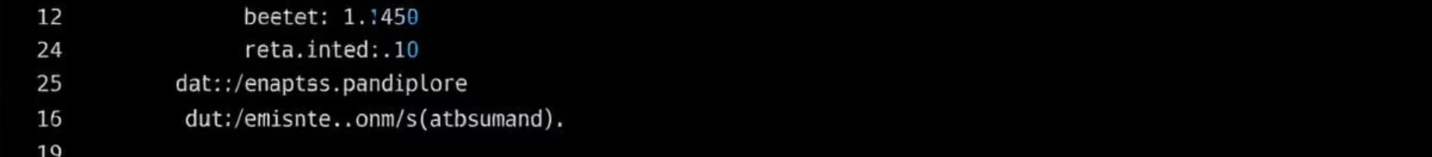




GCP Commands & Steps
Create GCS Bucket
gsutil mb -l us-central1 gs://bank-transaction-data/
Upload CSV & Scripts
gsutil cp CSVs and PySpark scripts to GCS. gsutil cp D:\csv_files*.csv gs://bank-transaction-data/ gsutil cp C:\Project files\clean_and_merge.py gs://bank-transaction-data/scripts/ gsutil cp C:\Project files\filter_failed_transactions.py gs://bank-transaction-data/scripts/
Create Dataproc Cluster
gcloud dataproc clusters create training-cluster. gcloud dataproc clusters create training-cluster --region=us-central1 --single-node
--enable-component-gateway --image-version=2.1-debian11 --project=tharunteja-project
Submit PySpark Jobs
Run clean_and_merge.py and filter_failed_transactions.py. gcloud dataproc jobs submit pyspark gs://bank-transaction data/scripts/clean_and_merge.py --cluster=training-cluster --region=us-central1
gcloud dataproc jobs submit pyspark gs://bank-transaction
data/scripts/filter_failed_transactions.py --cluster=training-cluster --region=us-central1

Slide 6

Data Schema Overview
txn_id
Transaction ID
branch_id
Branch Code
city
City Name
amount
Transaction Amount
transaction_status
SUCCESS or FAILED
txn_date
Transaction Date
customer_id
Customer Unique ID
Total transactions: 3,000 (15 files × 200 records each)

Slide 7
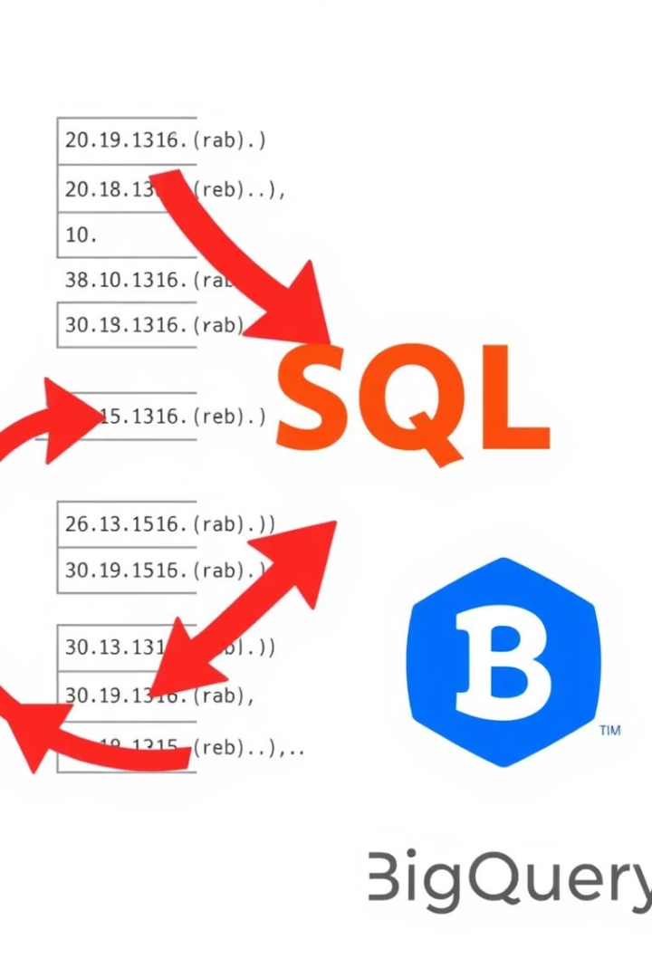
Cloud SQL & BigQuery Setup
Cloud SQL Table
BigQuery Dataset
Stores failed transactions with key fields. CREATE TABLE failed_transactions ( txn_id VARCHAR(100), branch_id VARCHAR(50), city VARCHAR(50), amount FLOAT, transaction_status VARCHAR(20), txn_date DATE, customer_id VARCHAR(50) );
Dataset created for bank analytics in US region.
Sample Query
Counts failed transactions grouped by city.

Slide 8
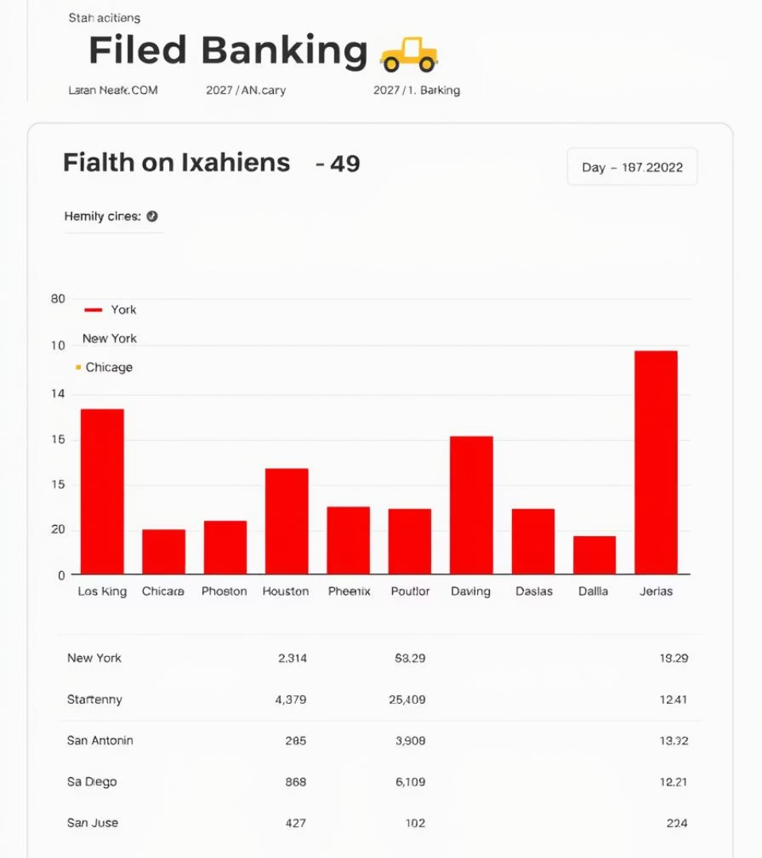
Looker Studio Visualization
Bar or pie chart shows city-wise failed transactions.
Hyderabad leads in failed transactions, followed by Chennai and Bangalore.
Hyderabad
Most failed transactions
Chennai
Second highest failures
Bangalore
Third in failed transactions

Slide 9

Project Conclusion
Automation
Full automation achieved using GCP services.
Data Processing
Cleaned and filtered 3,000 records with PySpark.
Storage
Centralized and secure data in Cloud SQL.
Visualization
Dashboards helped identify failure patterns easily.

Slide 10

Acknowledgements
Mentors & Team
Client
Thanks for guidance and support.
Grateful for the opportunity.
Google Cloud
Appreciate the powerful ecosystem.
Thank You! 🎉

